Slide 1
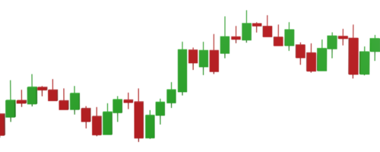
Revolutionizing Stock Market Intelligence: A Deep Dive into Machine Learning for IT Sector Price Predictions
Paper ID-247
Final Year Project CSE (2020-2024)
By: Mentor:
Parth Mishra Mr. Gaurav Parashar
Vaibhav Chaudhary
Ishant Sehgal

Slide 2
Introduction
The annual number of fluctuations and fluctuations in stock prices is projected to continue rising, with heightened market integration and technological advancements contributing to increased trading volumes and market complexity.
Machine learning has emerged as a powerful tool in stock price prediction, leveraging algorithms to analyze vast amounts of financial data and identify patterns or trends that may indicate future price movements.
By employing machine learning-based prediction models, investors and financial institutions can enhance their decision-making processes, mitigate risks, and capitalize on investment opportunities in the dynamic stock market environment.

Slide 3
Problem Description
Developing an accurate stock price prediction model is essential for investors and financial institutions (Fundamental VS Modern Technical)
Scalability, Performance, Long Term Horizon etc.
Explore Deep Learning Models and Overcome Challenges of Existing Research

Slide 4
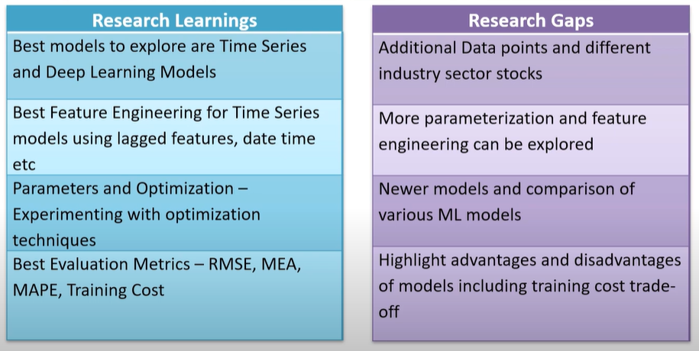
Research Learnings and Gaps

Slide 5
Technologies Used
Python
Sklearn
Numpy
Pandas
Matplotlib
Deep Learning Frameworks

Slide 6
Dataset
The Dataset is taken from Yahoo Finance data since 2014, including stock prices, trading volumes, market indices, and other financial indicators.

Slide 7
Date: This attribute represents the date of the financial data point.
Open: The opening price of the financial instrument on a particular trading day.
High: The highest price of the financial instrument during the trading day
Low: The lowest price of the financial instrument during the trading day.
Close: The closing price of the financial instrument on the trading day.
Adjusted Close: The closing price adjusted for dividends, stock splits, and other corporate actions.
Volume: The number of shares or contracts traded during the trading day.
Dividends: Any dividends paid out by the company during the trading period.
Symbol: The ticker symbol or identifier of the financial instrument.
Currency: The currency in which the financial instrument is traded.
Market Cap: The market capitalization of the company, calculated by multiplying the current stock price by the total number of outstanding shares.
Beta: A measure of a stock's volatility in relation to the overall market.
Dataset Description of Attributes

Slide 8
Algorithms to be used
Long short-term memory networks
Autoregressive integrated moving average
Prophet

Slide 9
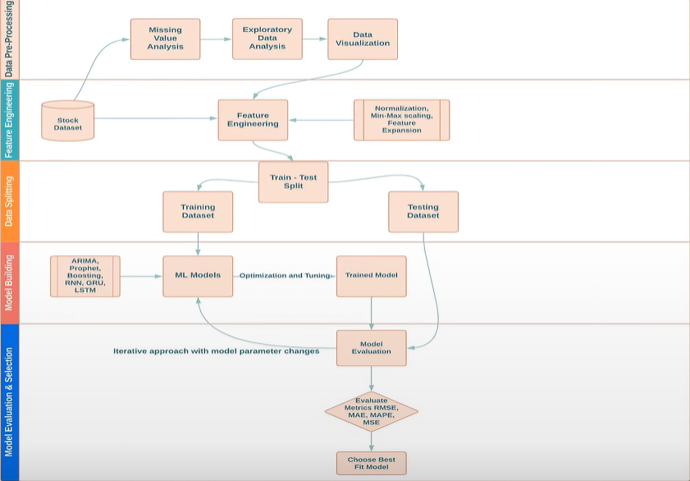
Methodology

Slide 10
LSTM
Long-Term Memory: LSTMs have a special architecture that allows them to retain information over long sequences, making them suitable for tasks where understanding context is critical.
Gates Control Information Flow: LSTMs use gates to regulate the flow of information, deciding what to remember, forget, and update at each time step.
Addressing Vanishing Gradient Problem: LSTMs mitigate the vanishing gradient problem, allowing gradients to propagate effectively over many time steps during training.
Flexibility in Sequence Length: LSTMs can process sequences of varying lengths, making them adaptable to different input sizes and suitable for tasks with variable-length inputs.
Training with Backpropagation Through Time: LSTMs are trained using backpropagation through time, adjusting internal parameters to optimize performance in sequence modeling tasks.

Slide 11
The LSTM model architecture was meticulously designed with two layers, each containing fifty hidden nodes, to capture the intricate temporal dependencies within the time series data. Hyperparameter tuning using Bayesian optimization identified the optimal dropout rate and optimizer (RMSprop), enhancing the model's performance. Training utilized the Adam optimizer and mean squared error loss function over 10 epochs, with early stopping implemented to prevent overfitting. The model demonstrated convergence within 50–100 epochs, indicating its ability to effectively learn from the sequential data.
Notably, the choice of batch size had a significant impact on execution time, albeit not on the model's accuracy. This observation aligns with the inherent characteristics of LSTM networks, where smaller batch sizes can lead to longer training times due to the sequential nature of processing. However, the careful consideration of hyperparameters, such as the window size of 100 days and the configuration of two LSTM layers with 20 hidden nodes each, struck a balance between computational efficiency and model effectiveness.
Furthermore, the default activation functions (tanh and sigmoid) were retained for the LSTM layers, as they are well-suited for capturing temporal dependencies in sequential data. The optimization process focused on fine-tuning the model parameters to best suit the distinctive traits of the provided time series data.

Slide 12
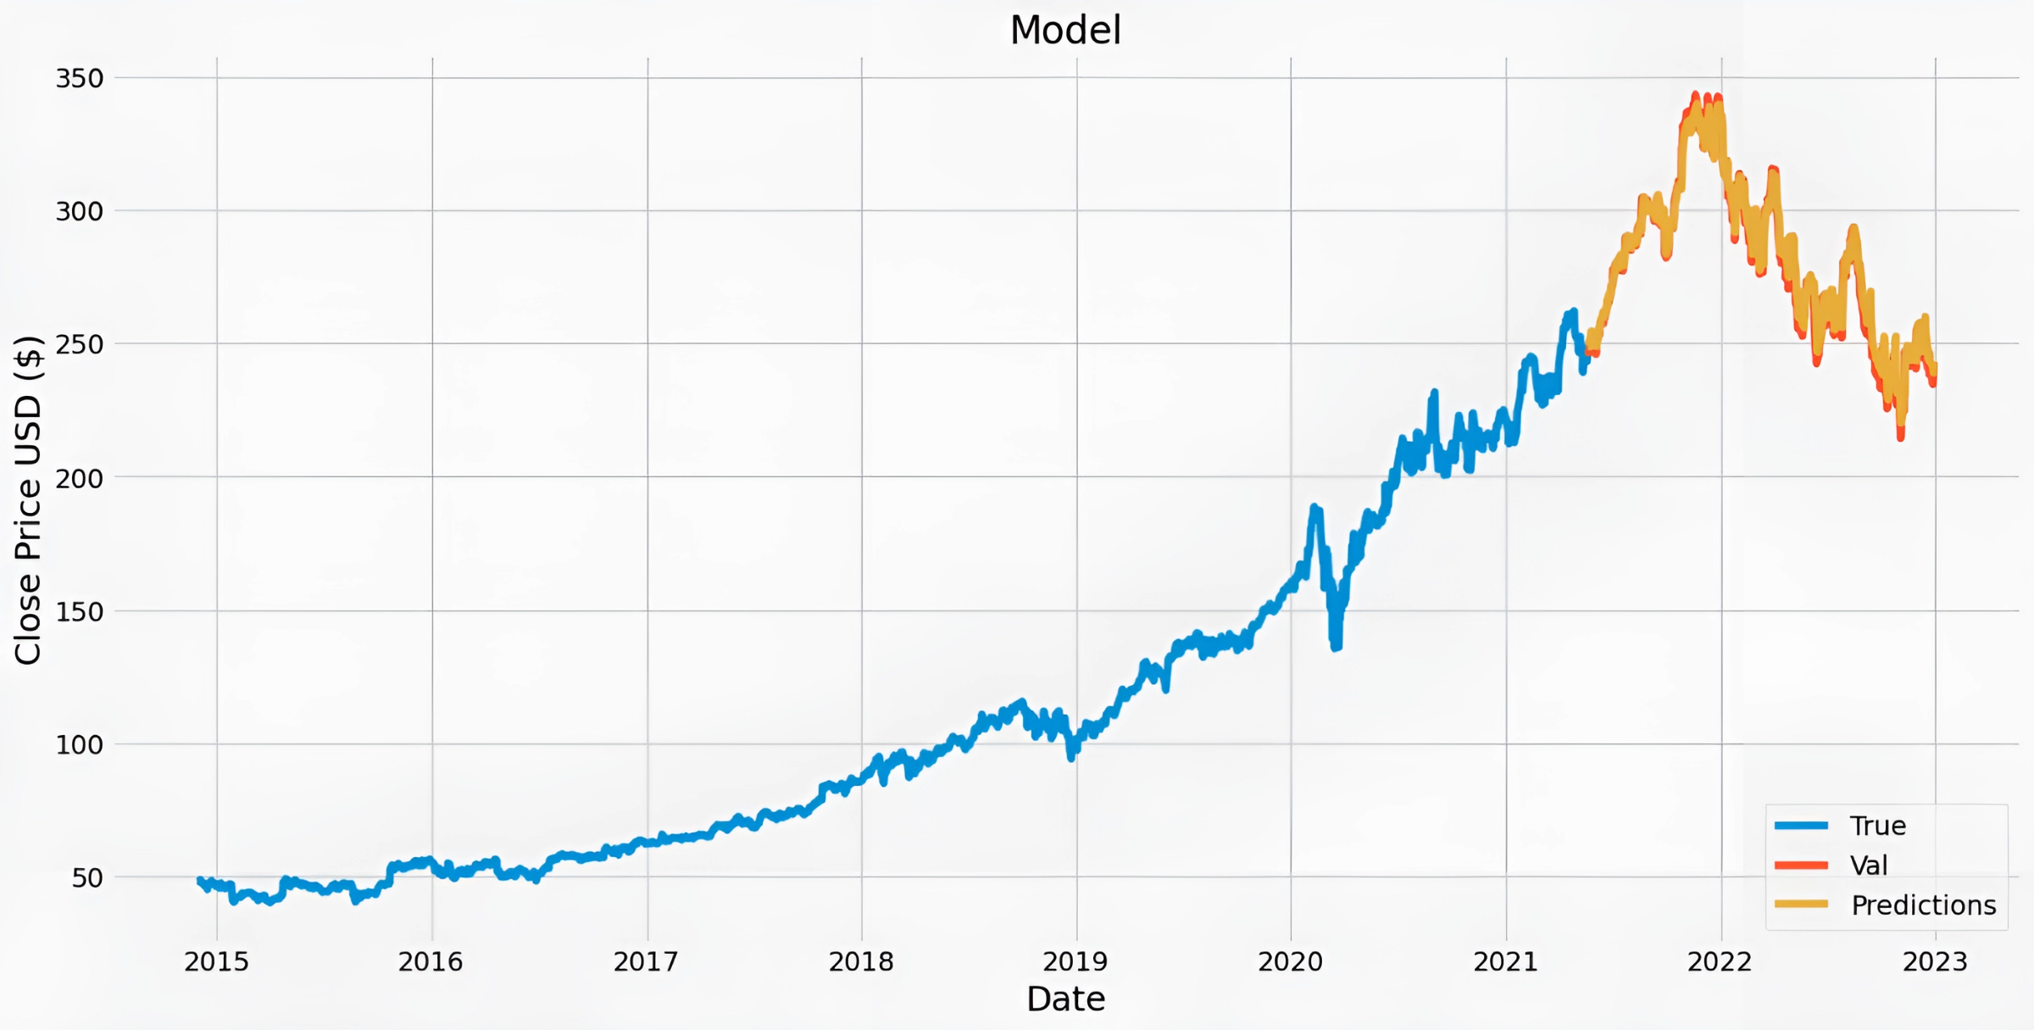
LSTM

Slide 13
ARIMA
Autoregressive (AR) Component: ARIMA models capture the linear relationship between an observation and a lagged value of the time series, reflecting how past values influence future ones.
Integrated (I) Component: ARIMA models difference the time series data to remove trends or non-stationarity, ensuring the data is stationary and allowing for more accurate modeling.
Moving Average (MA) Component: ARIMA models incorporate the dependency between an observation and a residual error from a moving average model applied to lagged observations.
Order Selection: ARIMA models require selecting appropriate orders (p, d, q) representing the number of autoregressive terms, differencing operations, and moving average terms, respectively, through analysis of autocorrelation and partial autocorrelation functions.
Forecasting: ARIMA models make predictions by extrapolating the patterns observed in historical data, providing insights into future behavior based on past trends and patterns.

Slide 14
The ARIMA (p, d, q) model is renowned in time series analysis for its ability to generate accurate short-term forecasts, often outperforming more complex structural models. When dealing with non-stationary time series data, it's essential to transform them into stationary ones through appropriate adjustments. The determination of ARIMA model orders involves examining observed patterns in sample autocorrelation functions (ACF) and sample partial autocorrelation functions (PACF) and aligning them with the theoretical patterns of known models to identify the suitable orders.
To convert non-stationary time series with short-term trends into stationary ones, differences can be applied. The basic equation of ARIMA (1, 0, 1) is particularly effective for such cases. ARIMA (1, 0, 1) includes an autoregressive term (AR(1)) to capture the trend in the data and a moving average term (MA(1)) to attenuate the effects of noise. This simplicity, effectiveness, and efficiency make ARIMA (1, 0, 1) a suitable choice for modeling non-stationary time series with short-term trends.
Prophet, an open-source library developed by Facebook's core data science team, offers an alternative approach to time series forecasting. It is based on decomposable models and enables users to make accurate predictions using straightforward parameters. Prophet is particularly effective for capturing non-linear trends, various seasonal patterns (annual, weekly, daily), and the influence of holidays on data. Its flexibility in accommodating custom seasonality and holiday effects makes it a valuable tool for time series forecasting tasks, especially with datasets exhibiting significant seasonal fluctuations.

Slide 15
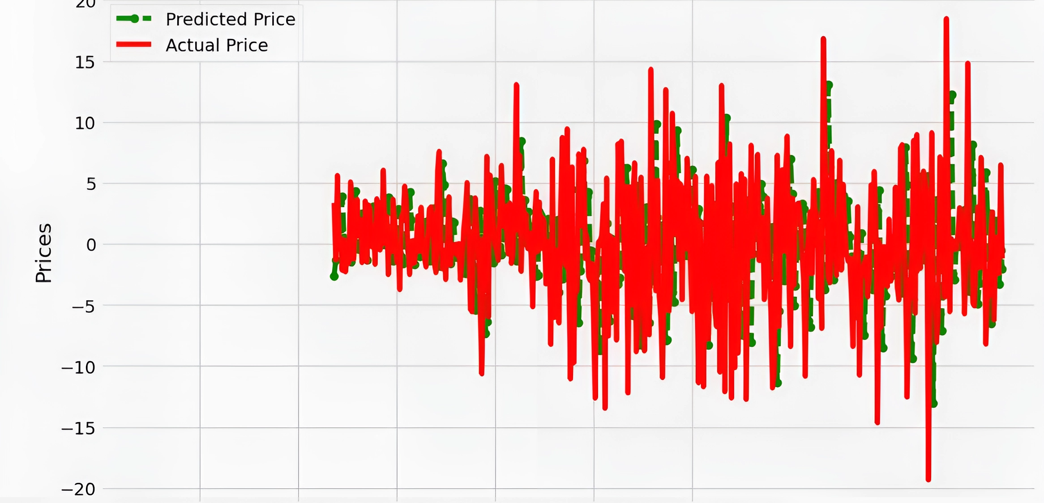
ARIMA

Slide 16
Prophet
Flexible Trend Modeling: Prophet automatically detects and models trends in the data, accommodating both linear and non-linear patterns, providing a versatile framework for capturing the underlying behavior.
Seasonality Handling: Prophet incorporates various types of seasonality, including daily, weekly, and yearly patterns, allowing it to effectively model recurring cycles and periodic fluctuations in the data.
Holiday Effects: Prophet enables the inclusion of holiday effects, allowing the model to account for the impact of holidays and special events on the time series data, enhancing the accuracy of forecasts during such periods.
Uncertainty Estimation: Prophet provides uncertainty estimation for forecasts by generating prediction intervals, which quantify the range within which future observations are likely to fall, accounting for both data variability and model uncertainty.

Slide 17
The Prophet model stands out for its resilience to missing data and its robustness in adapting to outliers and changes in trends, making it highly suitable for real-world prediction tasks where anomalies and poor data quality are common challenges. Crafted to capture non-linear trends, diverse seasonal patterns (annual, weekly, and daily), and the impact of holidays on data, Prophet emerges as a flexible and robust additive-based model for time series forecasting.
In preparation for using the Prophet model, the input data frame must contain two required columns: "ds" and "y". The "ds" column holds the date stamp, which must be formatted according to Pandas Library guidelines, allowing for dates (e.g., YYYY-MM-DD) or timestamps (e.g., HH:MM: SS). The "y" column contains numeric values representing the target measurement or attribute that the model aims to forecast.
Prophet offers a user-friendly and potent solution for time series forecasting, specifically tailored for datasets with pronounced seasonal effects and encompassing multiple seasons of historical data. It operates as an additive model composed of distinct components: the trend component (g(t)), the seasonality component modeled using the Fourier series (s(t)), and the component accounting for holiday effects (h(t)).

Slide 18
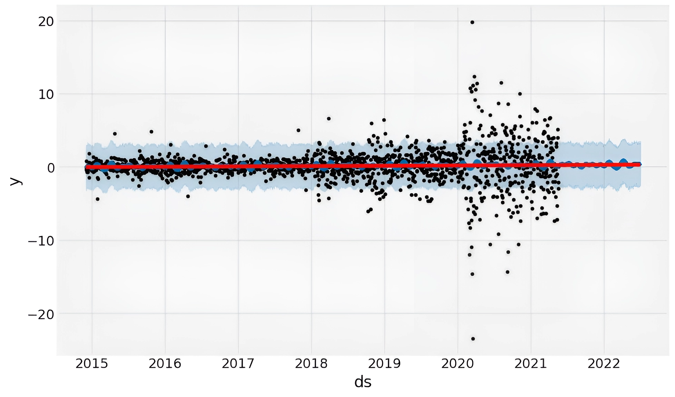
Prophet

Slide 19
Table Of RMSE
MODEL | RMSE
LSTM | 1.204
ARIMA | 6.615
Prophet | 4.527

Slide 20
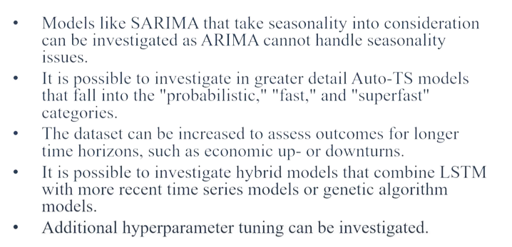
Future Recommendations

Slide 21
REFERENCES
[1] I.-C. Lolea, I.-R. Petrariu, and A. Giurgiu, “Arima vs. machine learning in terms of equity market forecasting,” The Annals of the University of Oradea. Economic Sciences, vol. 30, no. 2nd, 2021. 2https://www.kiet.edu/home/department wise club detail/NQ==/NA==/ student club
[2] S. Mehtab and J. Sen, “Stock price prediction using cnn and lstm-based deep learning models,” in 2020 International Conference on Decision Aid Sciences and Application (DASA), pp. 447–453, IEEE, 2020.
[3] M. Nabipour, P. Nayyeri, H. Jabani, S. Shahab, and A. Mosavi, “Predicting stock market trends using machine learning and deep learning algorithms via continuous and binary data; a comparative analysis,” IEEE Access, vol. 8, pp. 150199–150212, 2020.
[4] J. Sen and S. Mehtab, “Accurate stock price forecasting using robust and optimized deep learning models,” in 2021 International Conference on Intelligent Technologies (CONIT), pp. 1–9, IEEE, 2021.
[5] M. Obthong, N. Tantisantiwong, W. Jeamwatthanachai, and G. Wills, “A survey on machine learning for stock price prediction: algorithms and techniques,” in 2nd International Conference on Finance, Economics, Management and IT Business (05/05/20 - 06/05/20), pp. 63–71, May 2020. Publisher Copyright: Copyright © 2020 by SCITEPRESS - Science and Technology Publications, Lda. All rights reserved.

Slide 22
Thank you.!

